Slide 1

Assembly Language Programming
Lecture 1
Department of Computer Science & Engineering
Hajee Mohammad Danesh Science & Technology University

Slide 2
Outline
The Components of a Microcomputer System
Instruction Cycle
Programming Languages
How Integers Are Represented in the Computer
Character Representation
2

Slide 3
Bytes and Words
Information processed by the computer is stored in its memory.
The memory circuits are usually organized into groups that can store eight bits of data.
A string of eight bits is called a byte.
Each memory byte is identified by a number that is called address.
The data stored in a memory byte are called its contents.

Slide 4
Bytes and Words
The address of a memory byte is fixed and is different from the address of any other memory byte in the computer.
The contents of a memory byte are not unique and are subject to change, because they denote the data currently being stored.

Slide 5
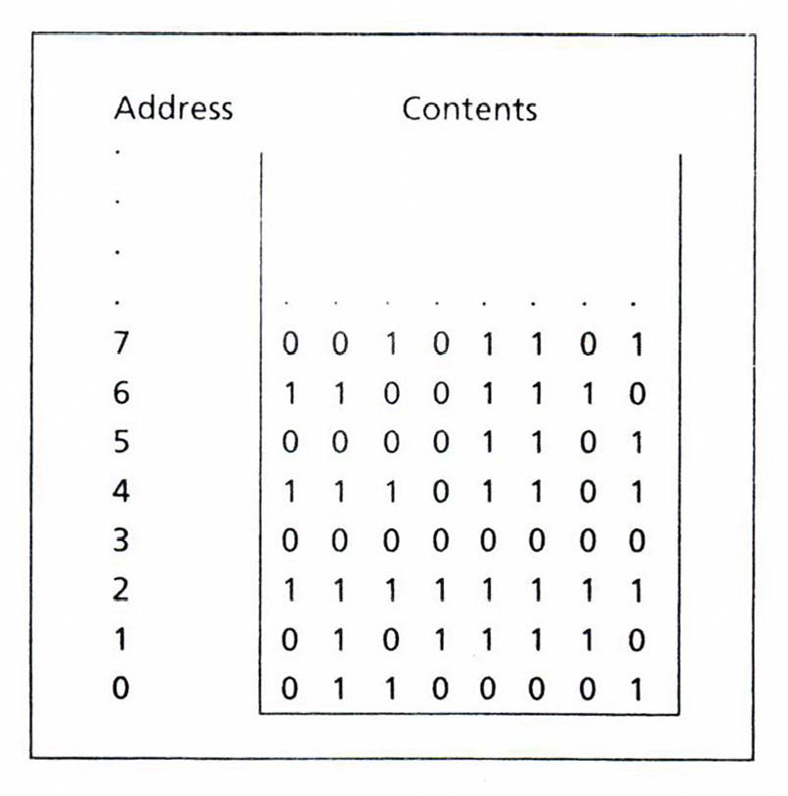
Memory Represented as Bytes
5

Slide 6
Bit Position
The positions are numbered from right to left, starting with 0.
In a word, the bits 0 to 7 form the low byte
and the bits 8 to 15 form the high byte.
For a word stored in memory, its low byte comes from the memory byte with the lower address and its high byte is from the memory byte with the higher address.
6

Slide 7
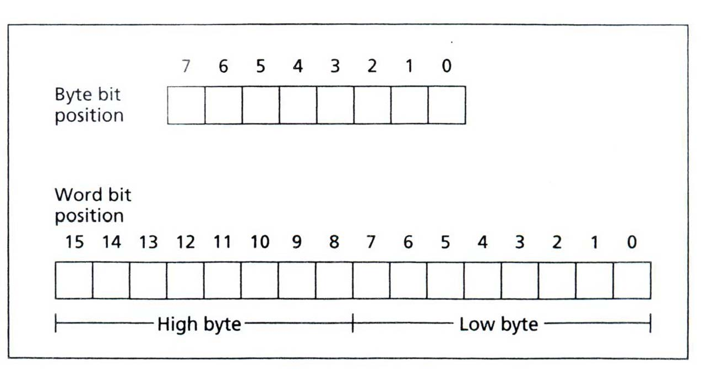
Bit Positions in a Byte and a Word
7

Slide 8
Buses
A processor communicates with memory and I/O circuits by using signals that travel along a set of wires or connections called buses.
There are three kinds of signals: address, data, and control.
And there are three buses: address bus, data bus, and control bus.

Slide 9
Buses
For example, to read the contents of a memory location, the CPU places the address of the memory location on the address bus, and it receives the data, sent by the memory circuits, on the data bus.
A control signal is required to inform the memory to perform a read operation.
The CPU sends the control signal on the control bus.

Slide 10
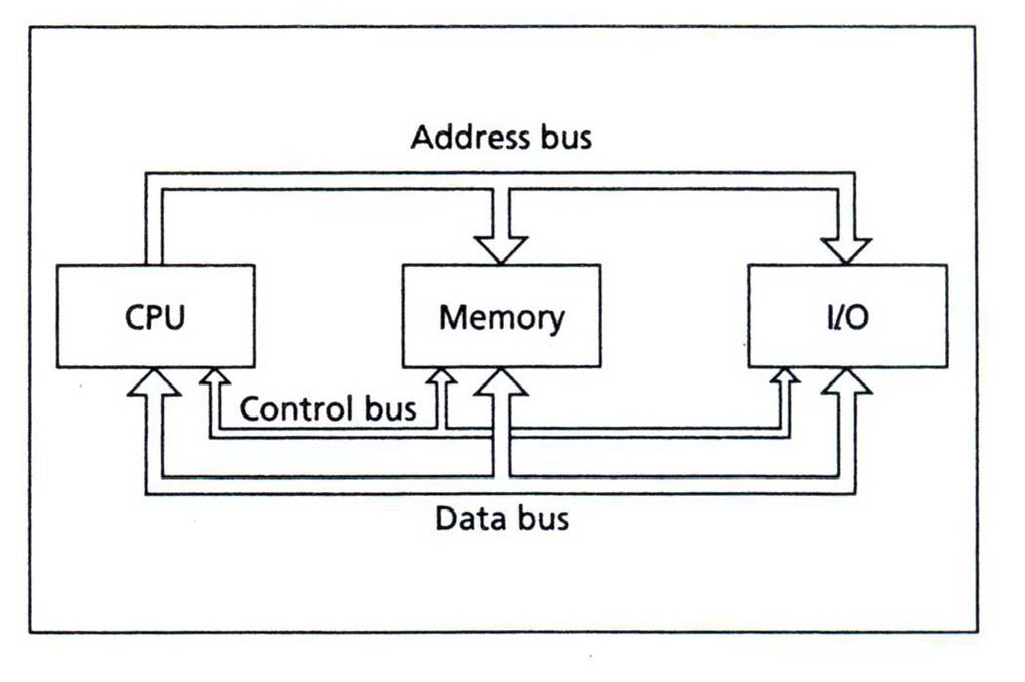
Bus Connections of a Microcomputer

Slide 11
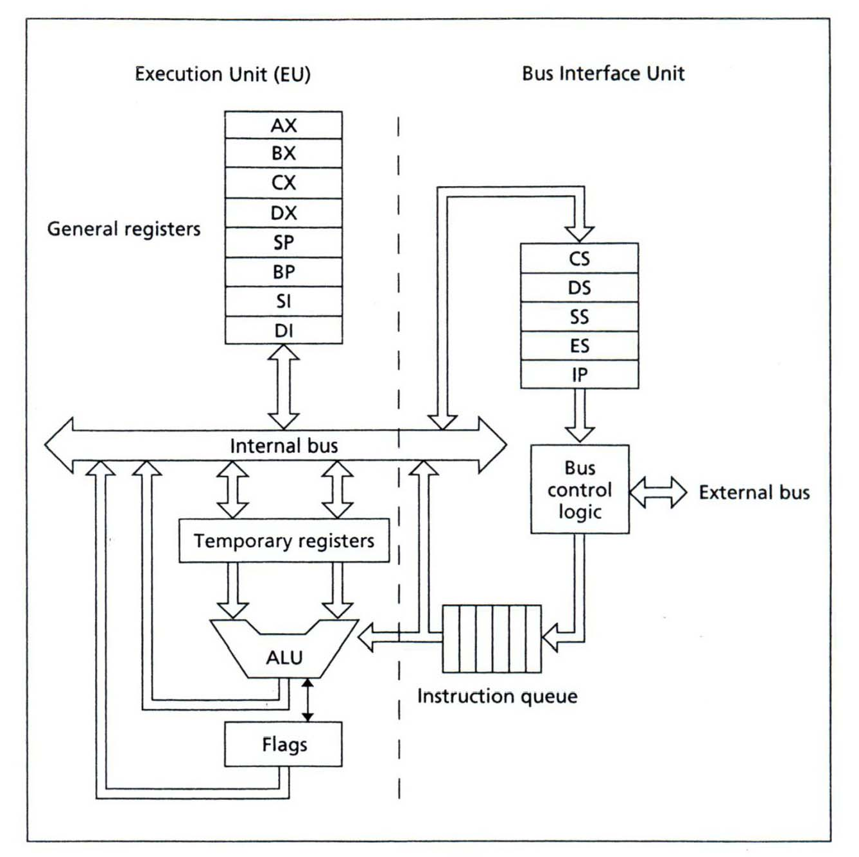
Intel 8086 Microprocessor Organization

Slide 12
Execution Unit (EU)
The purpose of the EU is to execute instructions.
The arithmetic and logic unit (ALU) can perform arithmetic (+, ‐, x, /) and logic (AND, OR, NOT) operations.
The data for the operations are stored in circuits called registers.

Slide 13
Bus Interface Unit (BIU)
The BIU facilitates communication between the EU and the memory or I/O circuits.
The BIU is responsible for transmitting addresses, data, and control signals on the buses.
The instruction pointer (IP) contains the address of the next instruction to be executed by the EU.

Slide 14
Instruction Prefetch
While the EU is executing an instruction, the BIU fetches up to six bytes of the next instruction and places them in the instruction queue.

Slide 15
Machine Instruction
The Opcode specifies the type of operation.
The Operands are often given as memory addresses to the data to be operated on.

Slide 16
Fetch‐Execute Cycle
Fetch
Fetch an instruction from memory.
Decode the instruction to determine the operation.
Fetch data from memory if necessary.
Execute
Perform the operation on the data.
Store the result in memory if needed.

Slide 17
Programming Languages
The operations of the computer’s hardware are controlled by its software.
When the computer is on, it is always in the process of executing instructions.

Slide 18
Machine Language
The CPU can only execute machine language instructions.
They are bit strings.

Slide 19
Machine Language
Machine Instruction Operation
10100001 00000000 00000000 Fetch the contents of
memory word 0 and put it in register AX.
00000101 00000100 00000000 Add 4 to AX.
10100011 00000000 00000000 Store the contents of
AX in memory word 0.
19

Slide 20
Assembly Language
A more convenient language to use is
assembly language.
In assembly language, we use symbolic names to represent operations, registers, and memory locations.
If location 0 is symbolized by A, the preceding program expressed in IBM PC assembly language would look like this:
20

Slide 21
Assembly Language
Assembly Instruction Comment
MOV AX, A ; fetch the contents of
; location A and put it in
; register AX
ADD AX, 4 MOV A, AX
; add 4 to AX
; move the contents of AX
; into location A

Slide 22
How Integers Are Represented in the Computer
The least significant bit (lsb) is the rightmost bit.
In a byte or word, bit 0
The most significant bit (msb) is the leftmost bit.
In a word, bit 15
In a byte, bit 7

Slide 23
Unsigned Integers
An unsigned integer represents a magnitude.
Unsigned integers are appropriate for representing quantities that can never be negative.
Addresses of memory locations
Counters
ASCII Code

Slide 24
Unsigned Integers
The largest unsigned that can be stored in a byte is 1111 1111= FFh = 255.
The biggest unsigned integer a 16‐bit word can hold is 1111 1111 1111 1111 = FFFFh
=65535.
Note that if the least significant bit of an integer is 1, the number is odd, and it’s even if the lsb is 0.
24

Slide 25
Signed Integers
A signed integer can be positive or negative.
The msb is reserved for the sign:
1 means negative.
0 means positive.
Negative integers are stored in the computer in a special way known as two’s complement.

Slide 26
Two’s complement
The one’s complement of an integer is obtained by complementing each bit; that is, replace each 0 by a 1 and each 1 by a 0.
To get the two s complement of an integer, just add 1 to its one’s complement.
’

Slide 27
Find the two’s complement of 5.
• 5 = 0000 000000000101
• One’s com. of 5 = 1111 1111 1111 1010
• Two’s com. of 5 = 1111 1111 1111 1011

Slide 28
Subtraction as Two’s Complement Addition
A subtraction can be done by bit complementation and addition.
The circuits that add and complement bits are easy to design.

Slide 29
Subtraction as Two’s Complement Addition
Ex.: Suppose AX contains 5ABCh and BX contains 21FCh. Find the difference of AX minus BX by using complementation and addition.
Solution: 5ABCh = 0101 1010 1011 1100
+ 1’s com. of 21FCh = 1101 1110 0000 0011
+1
Difference = 1 0011 1000 1100 0000
= 38C0h
Note that 21FCh = 0010 0001 1111 1100

Slide 30
Subtraction as Two’s Complement Addition
A one is carried out of the most significant bit and is lost.
The answer stored, 38C0h, is correct, as may be verified by hex subtraction.

Slide 31
Unsigned Decimal Interpretation
Just do a binary‐to‐decimal conversion.
It’s usually easier to convert binary to hex first, and then convert hex to decimal.

Slide 32
Signed Decimal Interpretation
If the msb is 0, the number is positive, and the signed decimal is the same as the unsigned decimal.
If the msb is 1, the number is negative, so call it –N.
To find N, just take the two’s complement and then convert to decimal as before.

Slide 33
Suppose AX contains FE0Ch. Give the unsigned and signed decimal interpretations.
• FE0Ch = 1111 1110 0000 1100
For the unsigned decimal interpretations
▪ FE0Ch = 65036
For the signed decimal interpretations
FE0Ch = –N
▪ One’s com. of FE0Ch = 0000 0001 1111 0011
▪ Two s com. of FE0Ch = 0000 0001 1111 0100
▪ N = 01F4h = 500
’

Slide 34
ASCII Code
American Standard Code for Information Interchange Code
The ASCII Code system uses seven bits to code each character, so there are a total of 2⁷ = 128 ASCII codes.
Notice that only 95 ASCII codes, from 32 to 126, are considered to be printable.

Slide 35
Show how the character string “RG 2z” is stored in memory, starting at address 0.
Address | Contents
0 | 0101 0010
1 | 0100 0111
2 | 0010 0000
3 | 0011 0010
4 | 0111 1010

Slide 36
Reference
Ytha Yu and Charles Marut, Assembly Language Programming and Organization of the IBM PC. New York: McGraw‐Hill, 1992.

